Slide 1
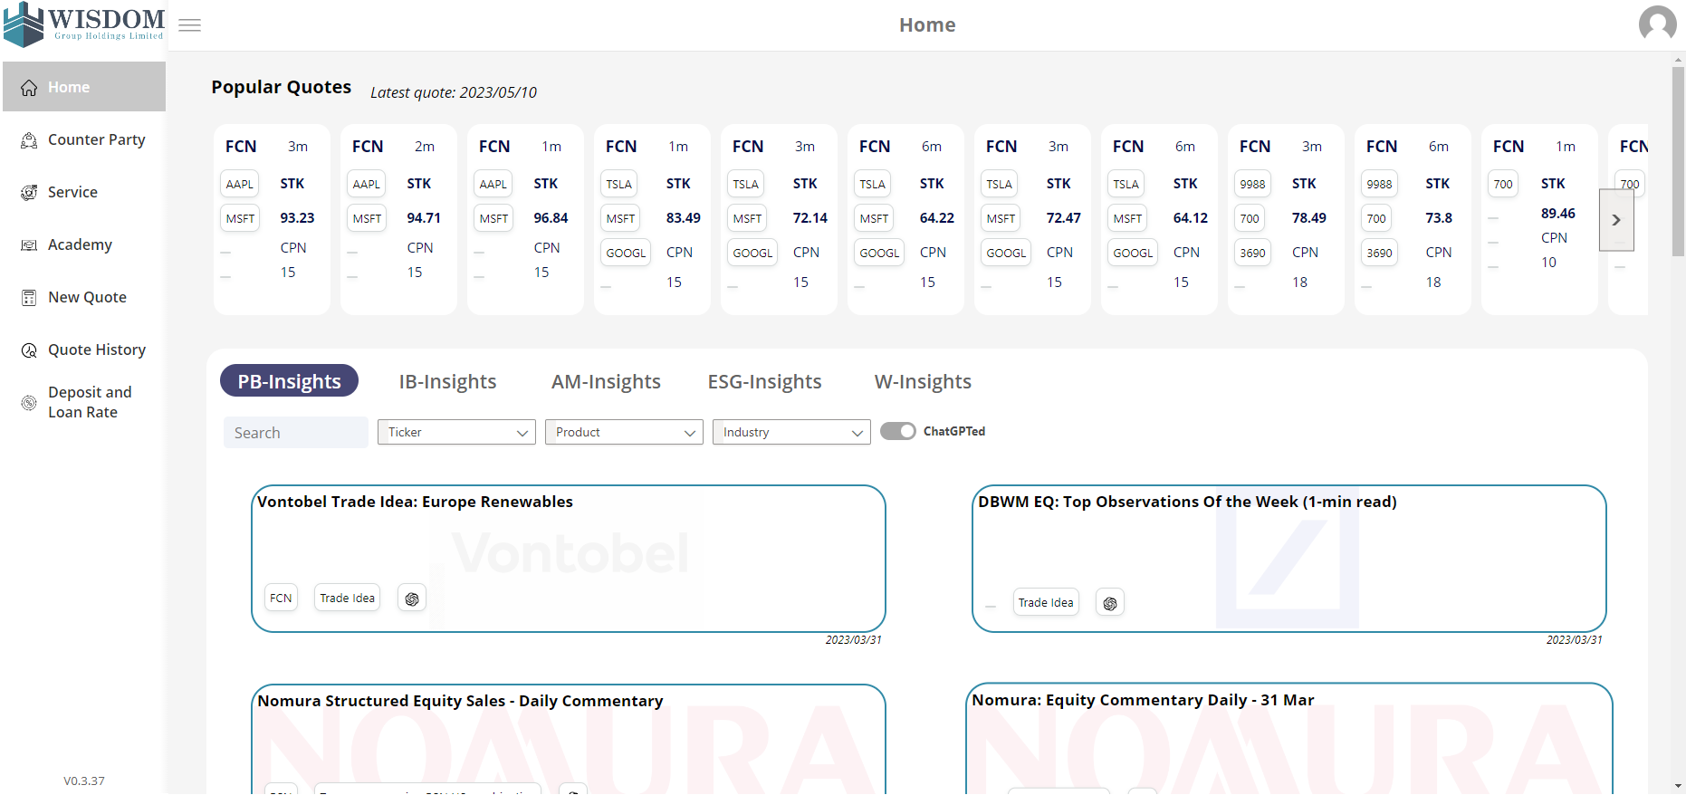
DDI Tools to Empower Your Workflow

Slide 2
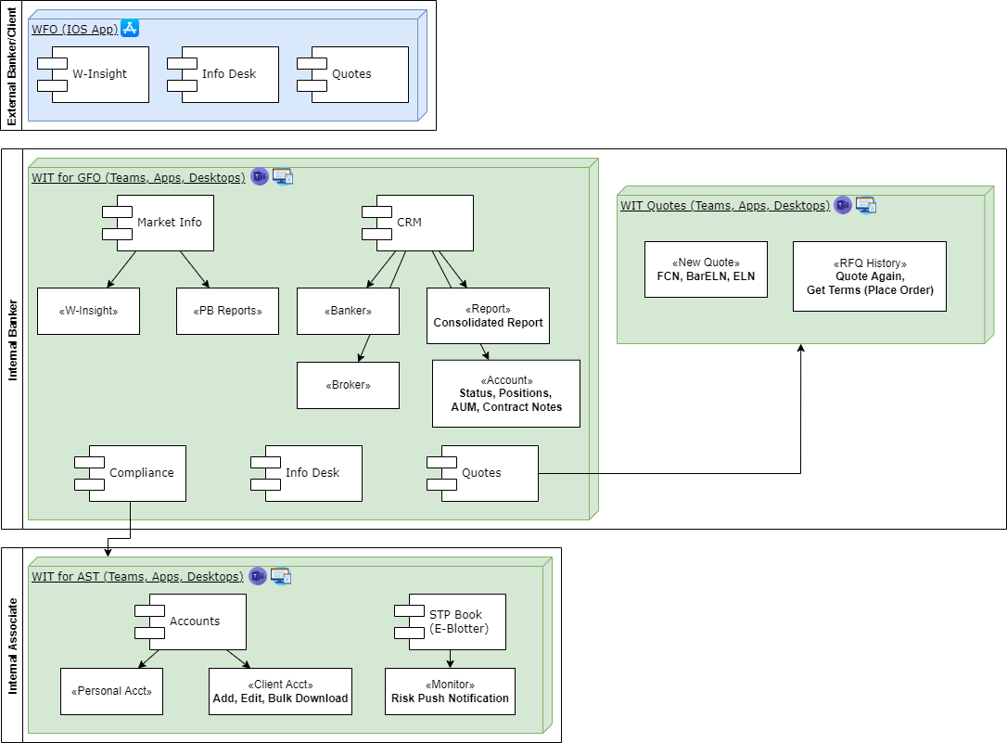
DDI – What We have Solved for You
Counter Party Info
STP Quotes
Market Insight
Acct Mngt
Asset Mngt
Report
Risk Mngt

Slide 3


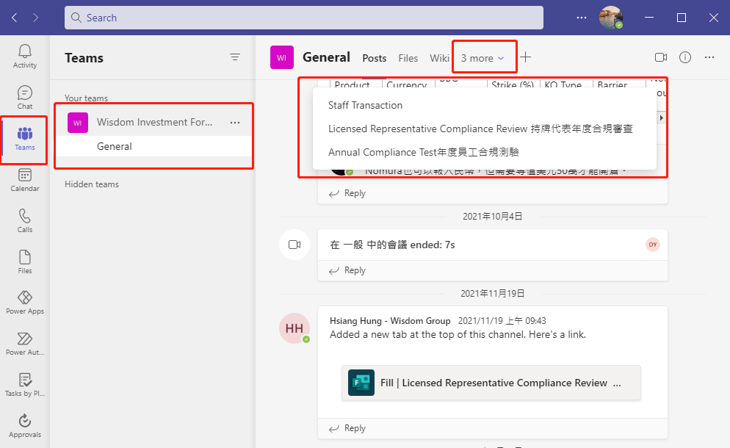
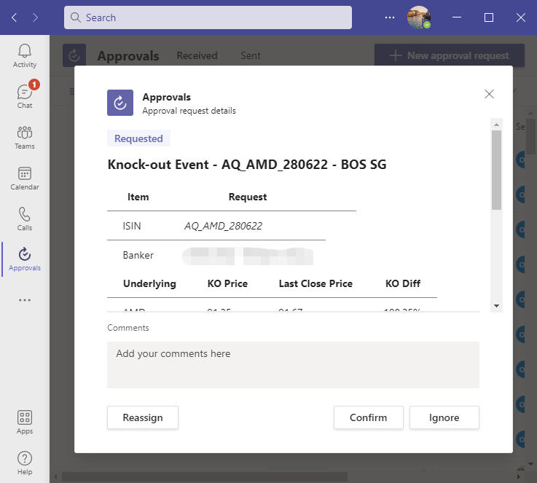
WISDOM DDI
Software application
All applications are integrated with Teams, regardless of device
Teams

Slide 4
DDI – WIT Road Map

Slide 5
DDI – WIT Road Map

Slide 6
DDI – WIT Road Map

Slide 7
DDI – WIT Road Map

Slide 8
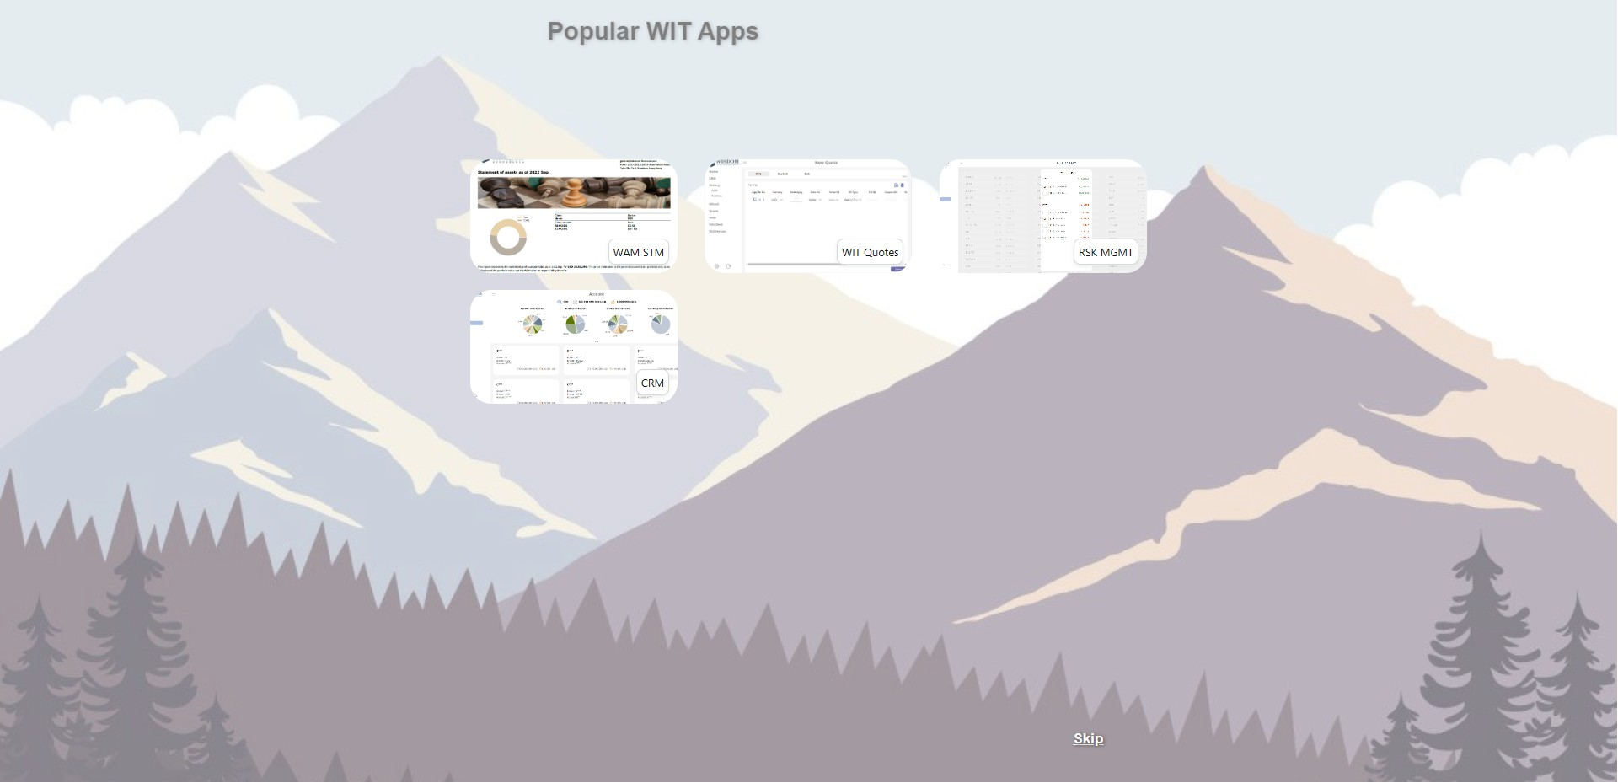

Slide 9
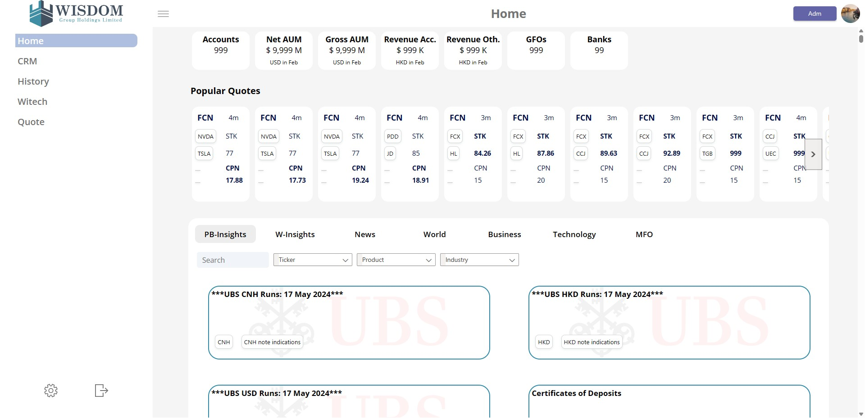

Slide 10
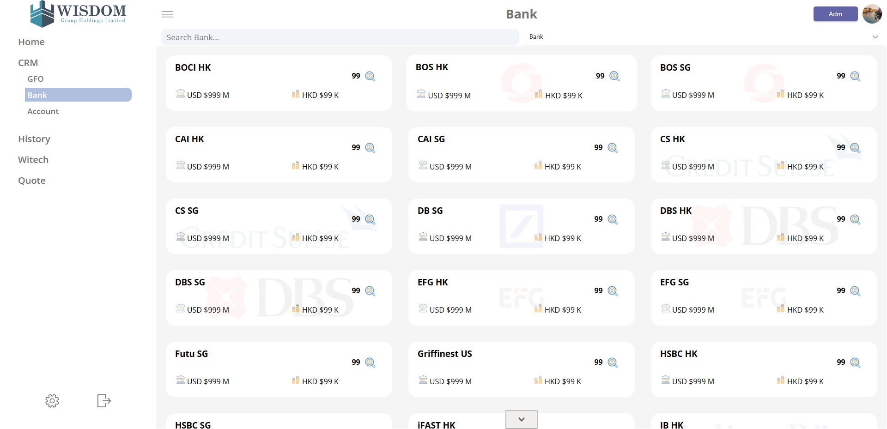

Slide 11
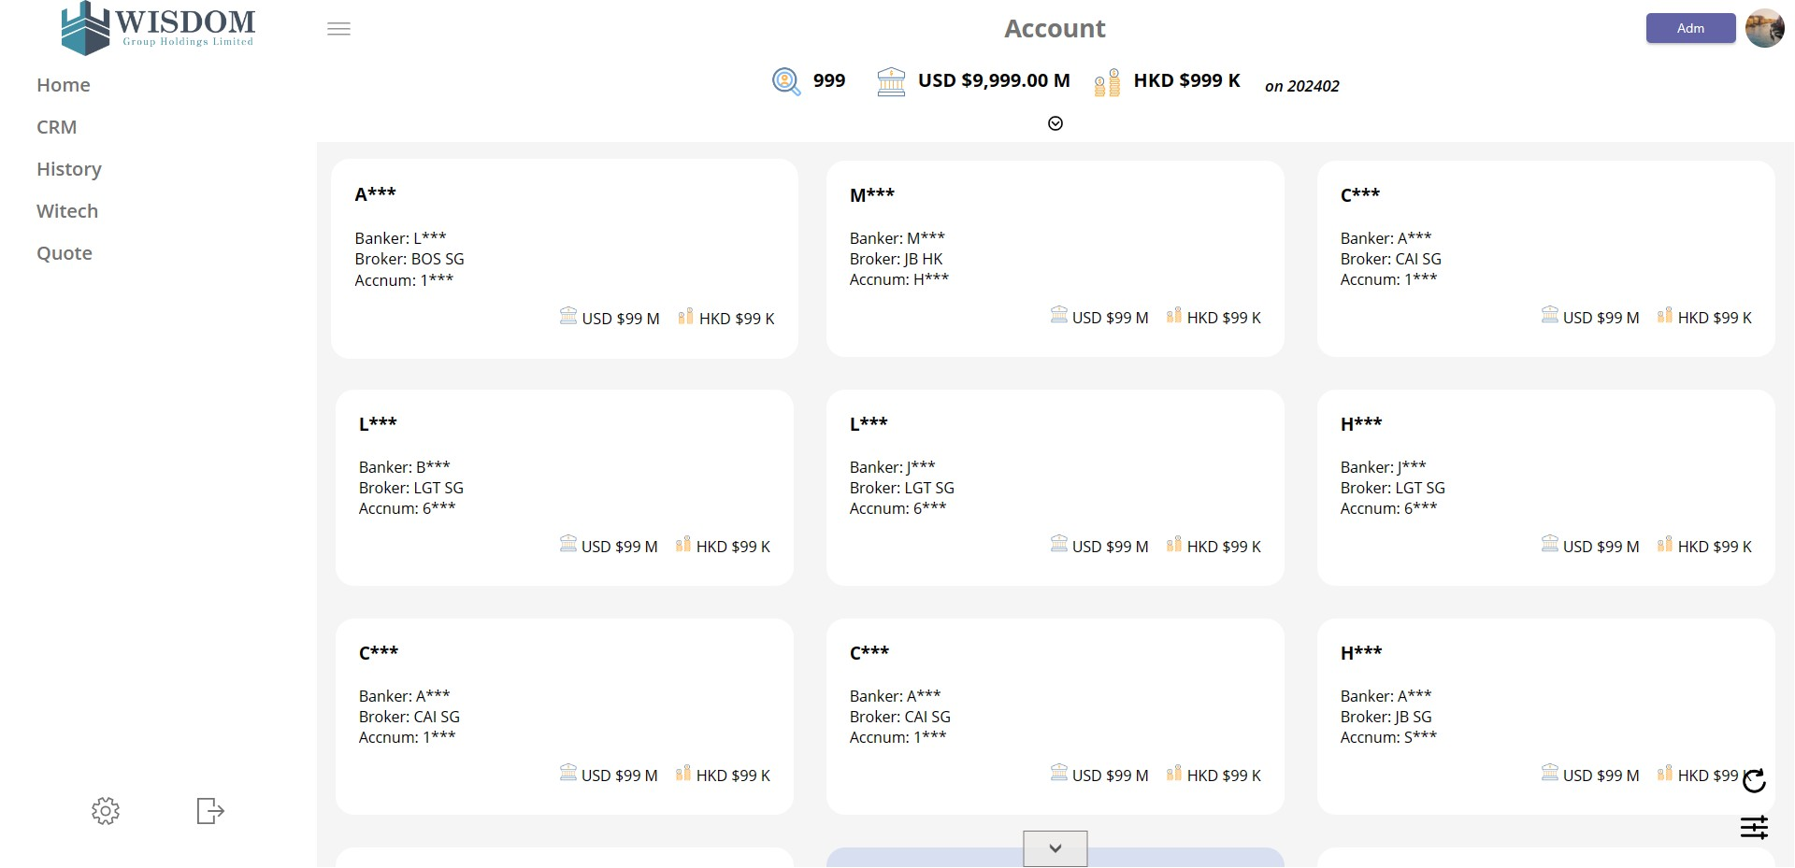

Slide 12
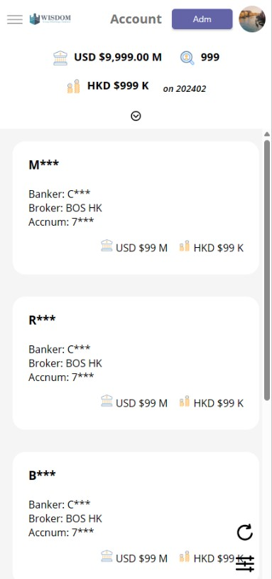

Slide 13
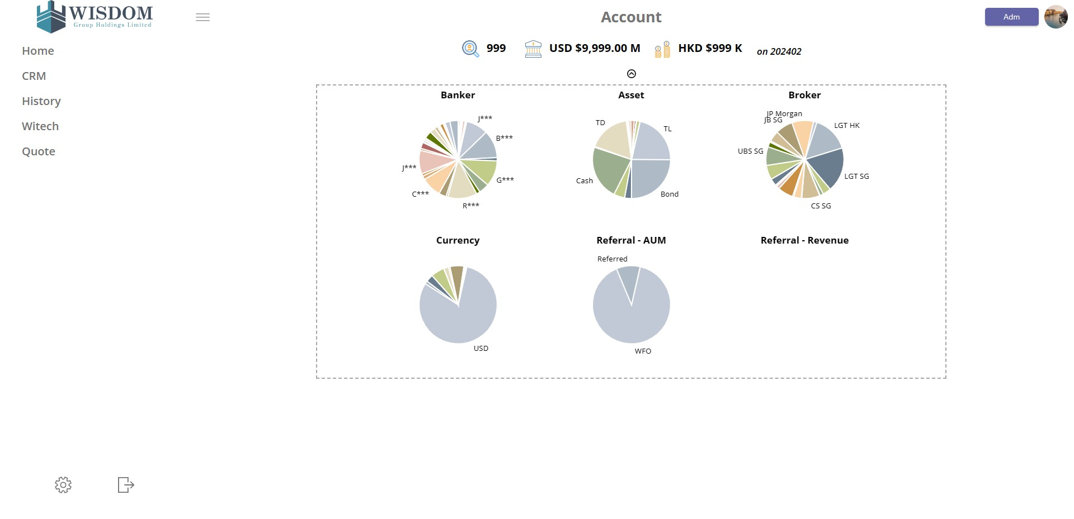

Slide 14
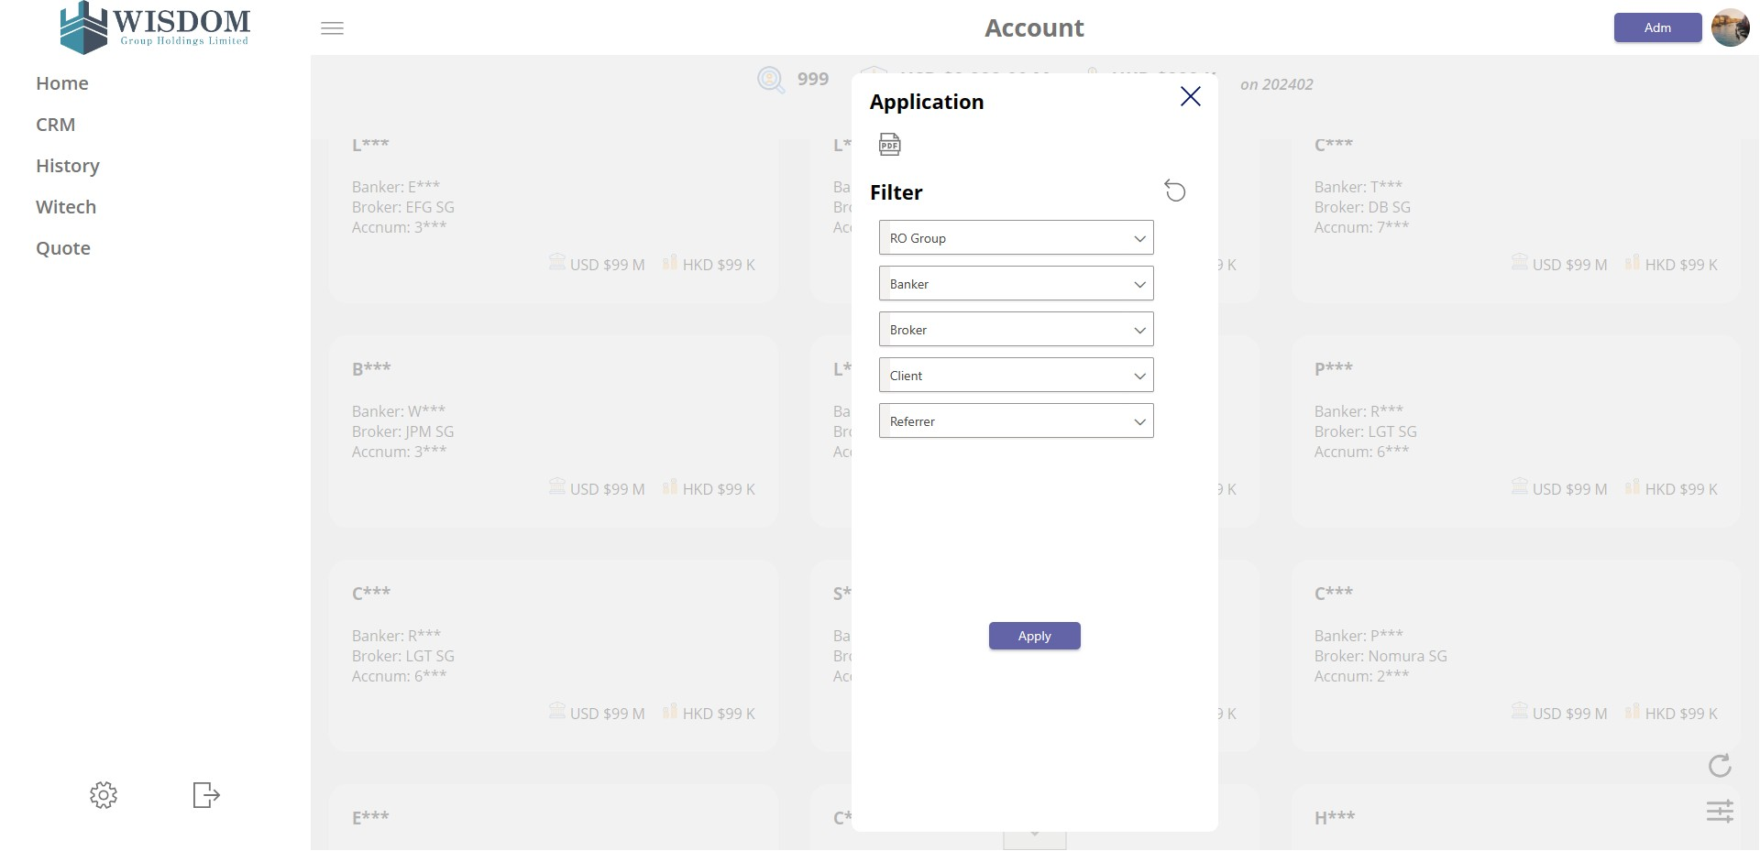

Slide 15
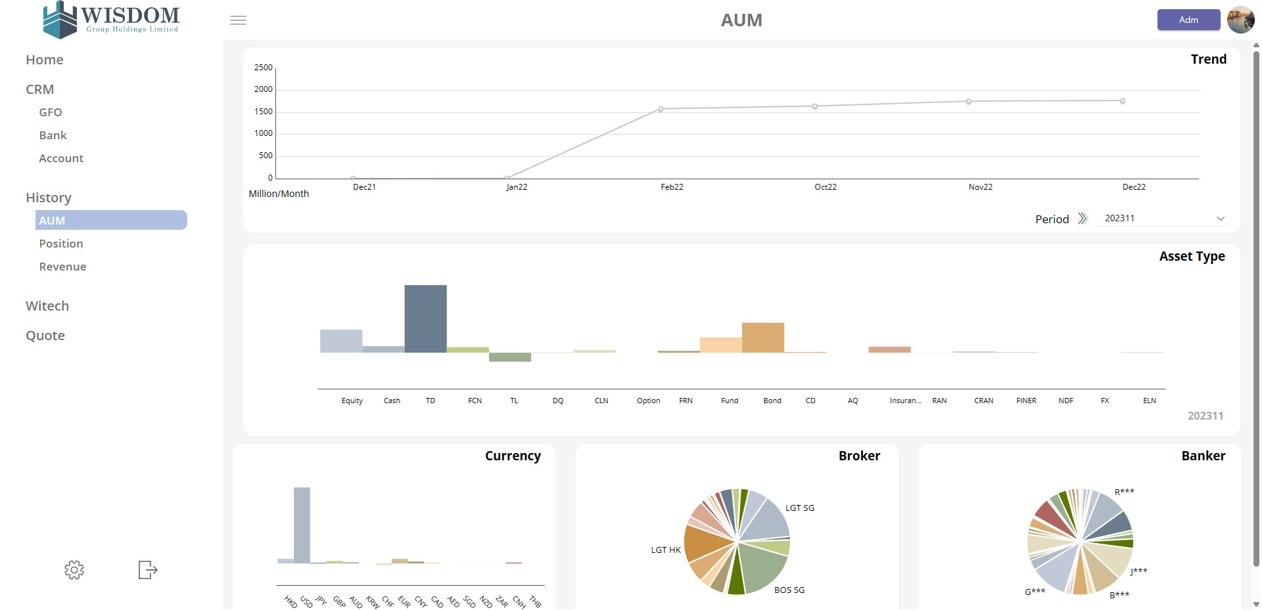

Slide 16
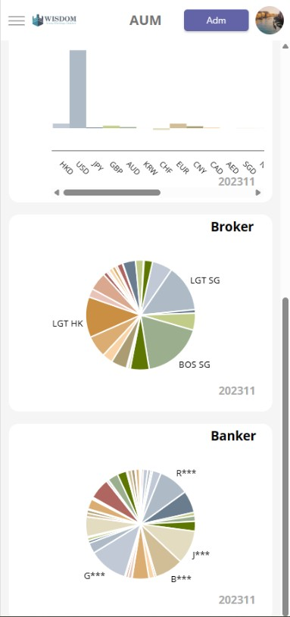

Slide 17
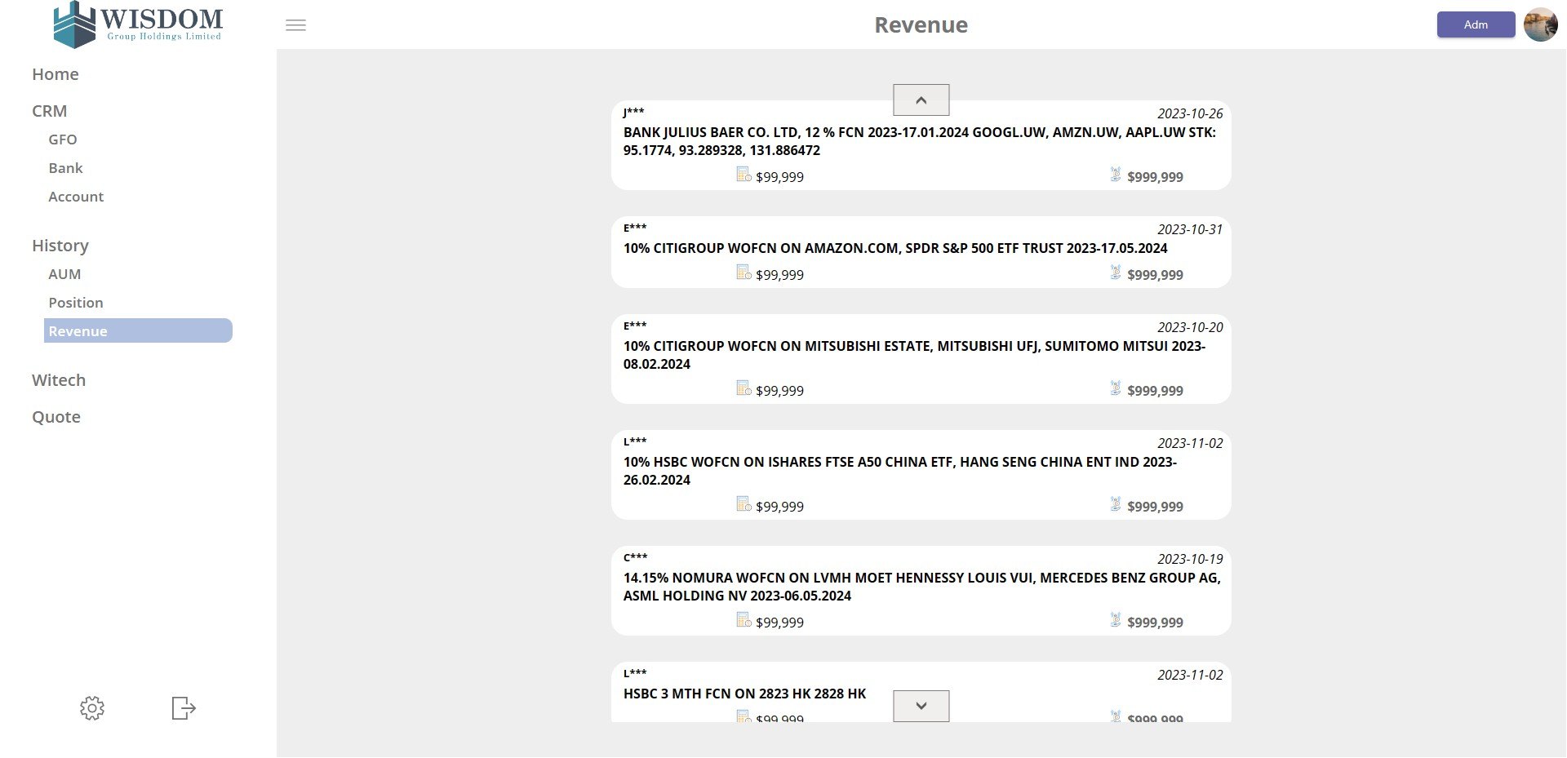

Slide 18
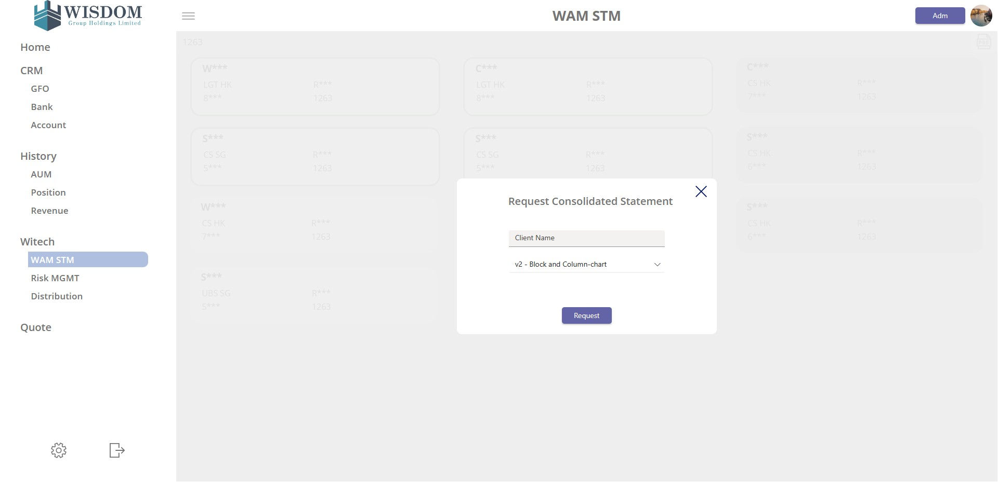

Slide 19
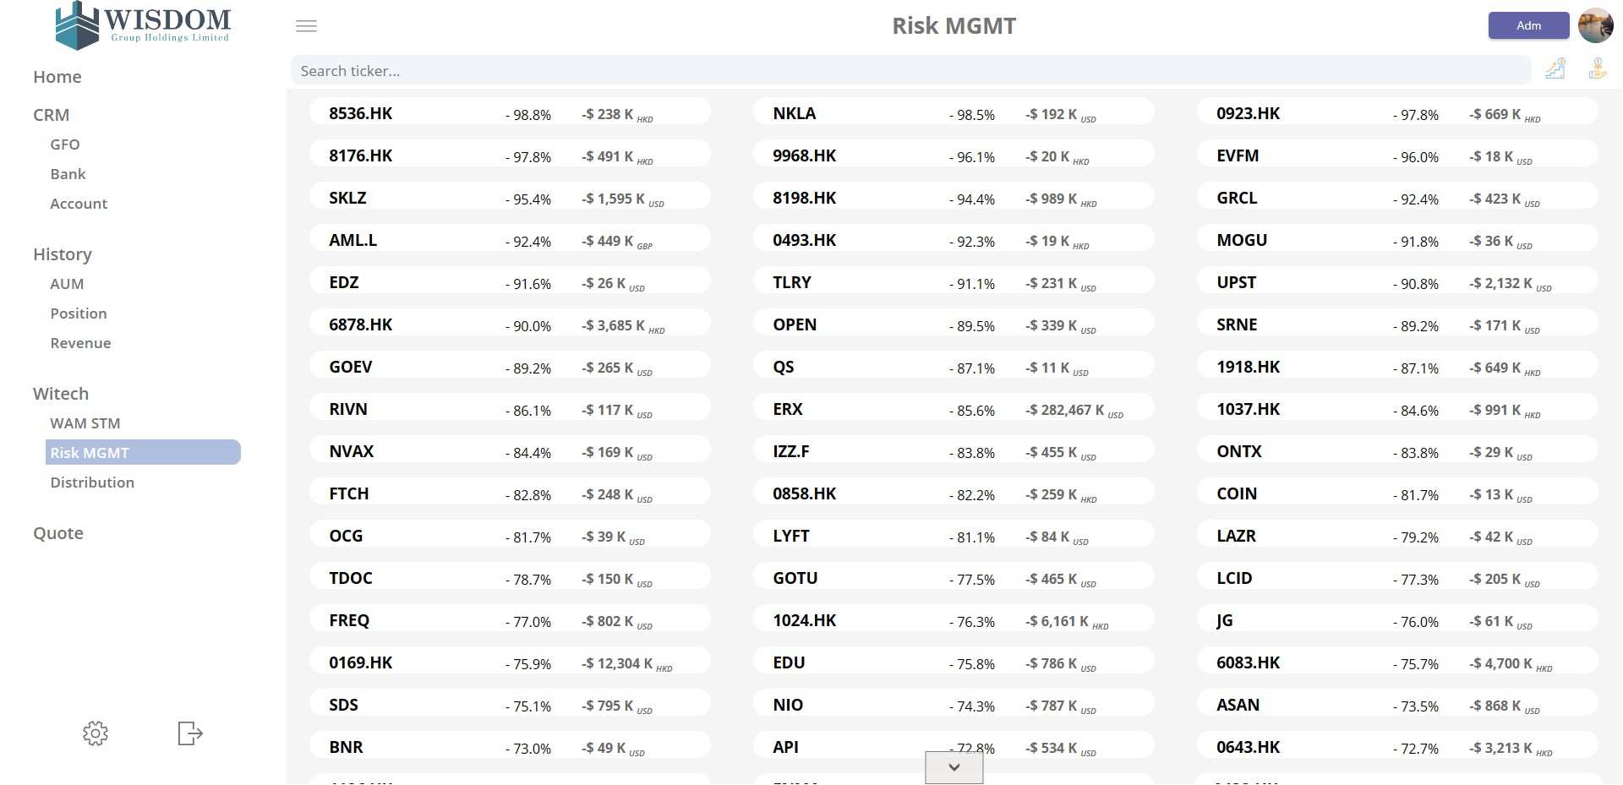

Slide 20
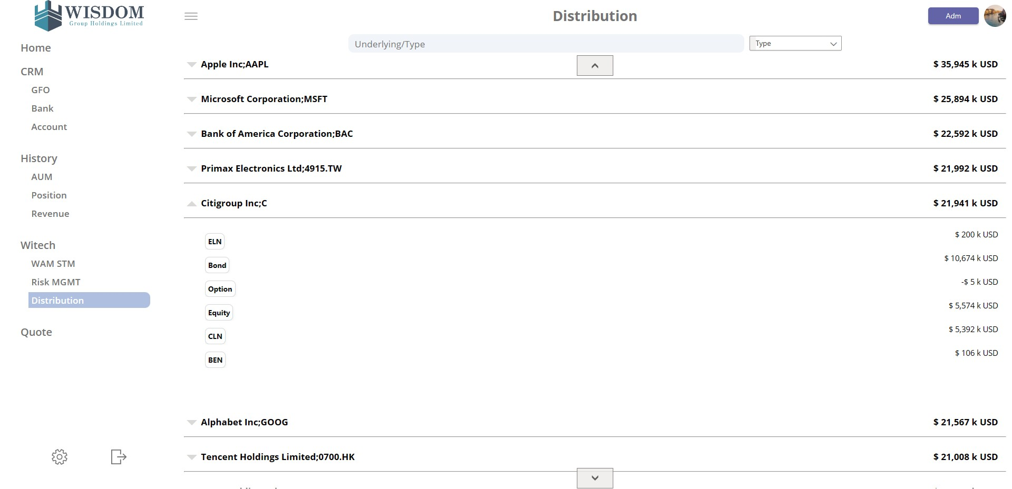

Slide 21
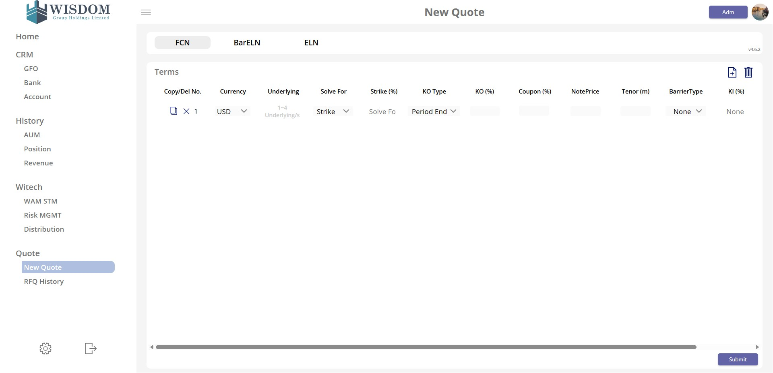

Slide 22
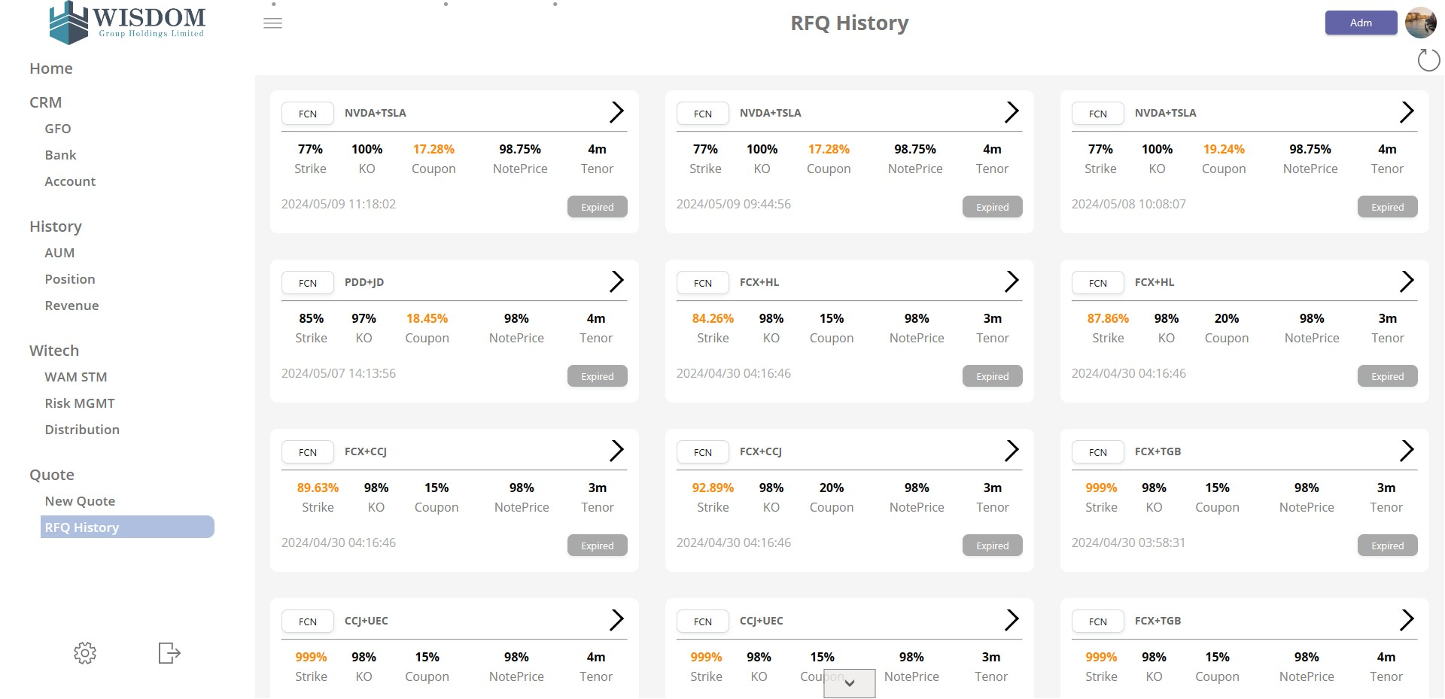

Slide 23
